Slide 1
General License Course
Chapter 7.1
Dipoles and Ground Planes

Slide 2
Antenna Basics
Definitions:
Elements – the conducting portion of an antenna that radiates or receives a signal
Polarization – refers to the orientation of the electric field radiated by the antenna (vertical, horizontal, circular)
Feed point impedance – the ratio of RF voltage to RF current at an antenna’s feed point (R = E ÷ I)
Resonant – when an antenna's feed point impedance is completely resistive (X_{L} = X_{C})
Radiation pattern – a graph of an antenna's signal strength in every compass direction or vertical angle

Slide 3
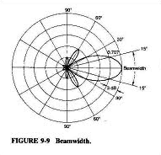
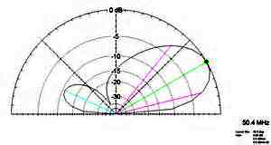
Antenna Basics
Definitions:
Azimuthal pattern – signal strength in horizontal (compass) directions
Elevation pattern – signal strength in a vertical direction (a side view of the major lobe)
Lobes – regions in the radiation pattern where the antenna is radiating a signal
Nulls – points at which radiation is at a minimum between lobes
Isotropic – antenna radiates equally in every possible direction (a point source, only a reference antenna)

Slide 4
Antenna Basics
Omnidirectional – antenna radiates a signal of equal strength in every horizontal (compass) direction
Directional – antenna radiates preferentially in one or more directions
Gain – concentration of signal transmitted toward or received from a specific direction. Gain ratios are measured in dB
Front-to-back ratio – ratio of gain in a forward direction to the opposite direction
Front-to-side ratio – ratio of gain in a forward direction to directions at right angles
Standing wave ratio (SWR) equals the ratio of the antenna's input impedance to the impedance of the feed line

Slide 5
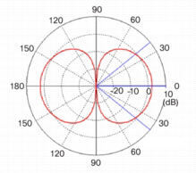
Dipoles
The dipole antenna is a straight conductor, usually ½ wavelength (λ) long with a feed point in the middle
A dipole radiates best broadside to its axis and weaker off the ends (see next slide)
The shape of the azimuthal pattern for a dipole in free space (far above ground) “in a plane containing the conductor” is a Figure-8 at right angles to the dipole
The feed point impedance of a center-fed dipole is approximately 72 Ω but varies depending on height
The feed point impedance of a dipole increases as it is moved away from the center of the dipole – an end-fed ½ λ dipole would have a VERY high feed point impedance

Slide 6
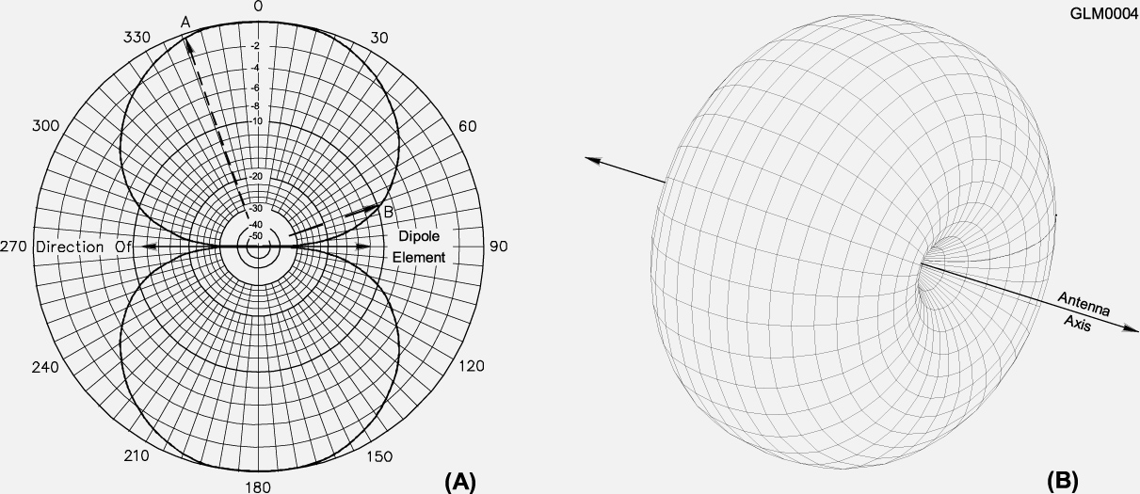
Dipoles
“Gain” = 2.15dBi (see next slide)

Slide 7
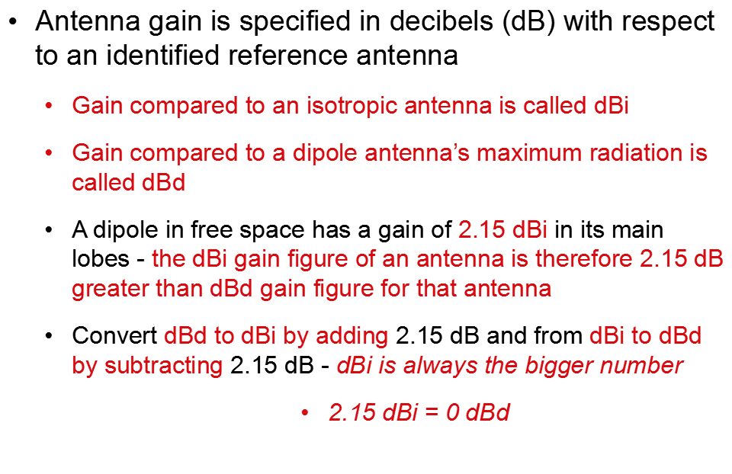
dBd vs dBi

Slide 8
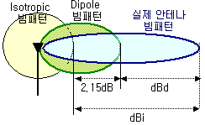
If the gain represented by the blue lobe equals 5 dBd, it can also be expressed as 7.15 dBi

Slide 9
Dipole
Center-fed dipoles are generally a good match for 50 to 75 Ω coax at common heights
In free space, ½ wavelength (λ) in feet equals 492 divided by frequency in MHz
Practical ½-wave dipoles are shorter than 492/f because of velocity factor - signals move ~5% more slowly in wire than in free space - Dipole approx. length = ~468/freq in MHz

Slide 10
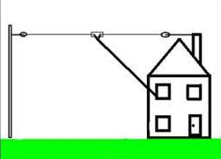
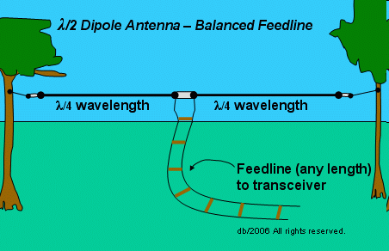
Dipoles
33 feet is the approximate length for a 1/2-wave dipole antenna cut for 14.250 MHz (20 meters)
Calculate ½ wavelength in feet by dividing 468 by the frequency in MHz. 468 / 14.250 = 32.8 Feet (~33 feet)
The approximate length for a 1/2-wave dipole antenna cut for 3.550 MHz (80 meters) is 132 feet.
Calculate ½ wavelength in feet by dividing 468 by the frequency in Mhz. 468 / 3.550 = 131.8 Feet (~132 feet)

Slide 11
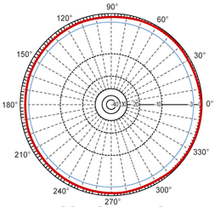
Effects Of Height Above Ground
Below 1/4 wavelength in height, the antenna's feed point impedance steadily decreases until it is close to zero at ground level
Above 1/4 wavelength in height the impedance varies, eventually reaching a stable value at a height of several wavelengths
Height also affects the radiation pattern - Below ½ wavelength, the dipole pattern is almost omnidirectional. Greater heights cause the pattern to develop lobes and nulls (a figure-8 pattern)

Slide 12
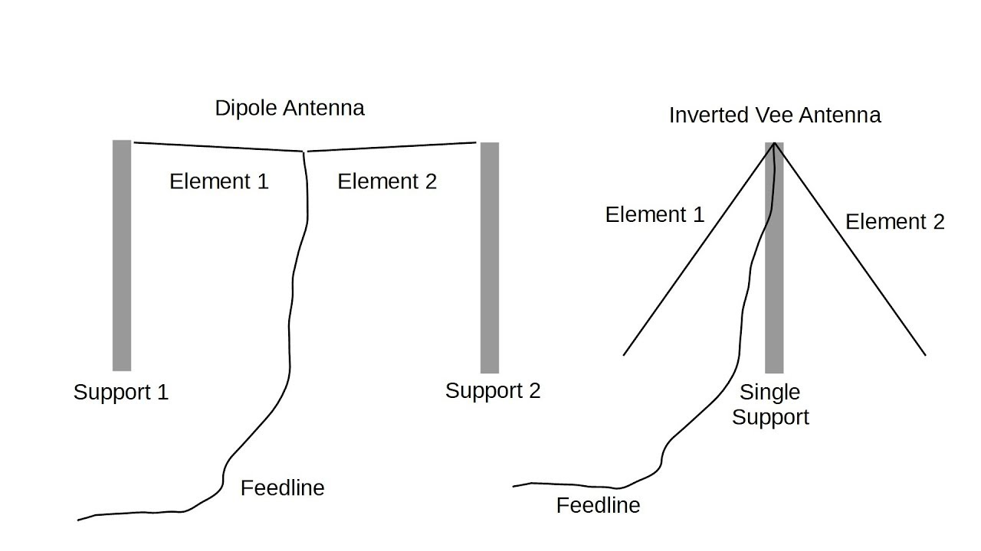
Inverted V Antenna
A dipole with a single central support is commonly referred to as an Inverted V
The downward slope of the legs cause the feed point impedance to drop to ~50 ohms
Inverted Vs are largely omnidirectional

Slide 13
Ground Planes (Verticals)
The basic ground plane antenna is ¼ λ vertical element over a ground plane. It radiates omnidirectionally in azimuth
A ¼ λ vertical for 28.5 MHz is ~8 feet tall
Ground plane antenna length is 234/frequency in MHz (OR 1/2 the equivalent Dipole length [= 468/F]) 234 / 28.5 MHz = 8.2 feet (round to 8)
Currents in the ground plane create the effect of an electrical image of the missing half, providing a low resistance return path for antenna current
The ground plane can be made from sheet metal, a wire grid, or individual radial wires

Slide 14
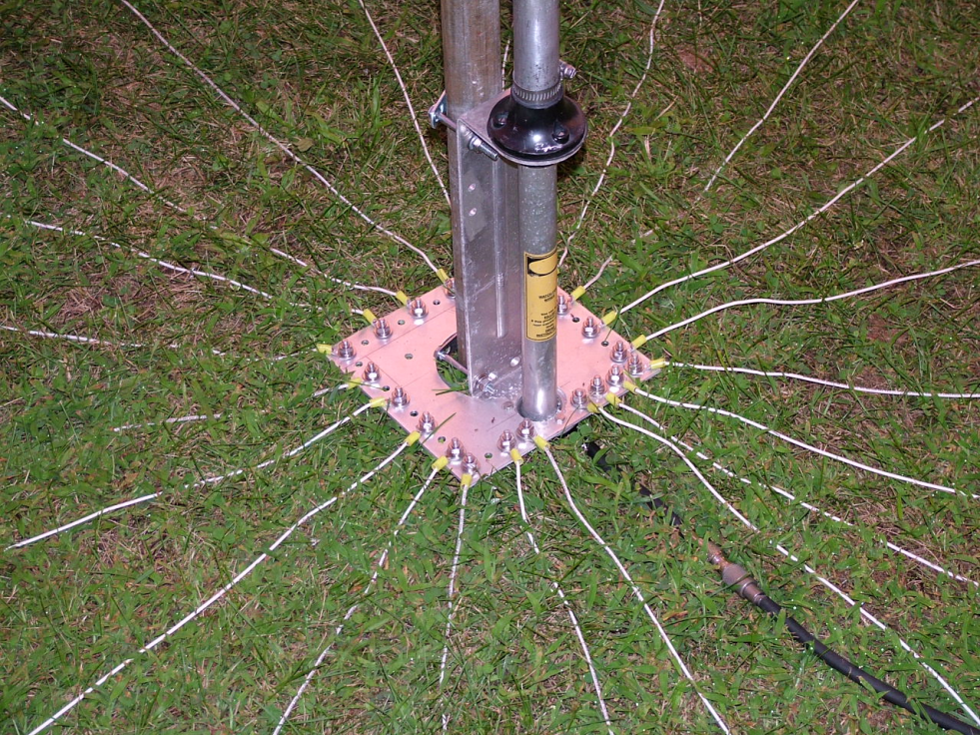
Ground Plane Vertical
Ground-mounted ground plane antennas have radial wires laid on the surface or buried within a few inches of the surface
Feed point impedance of a ground plane antenna (with a good ground return system) is approximately 35Ω (half a dipole)
Sloping elevated radials downward by 30 to 45 degrees will raise the feed point impedance to approximately 50Ω

Slide 15
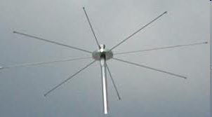
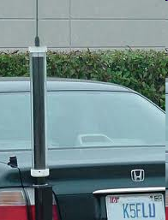
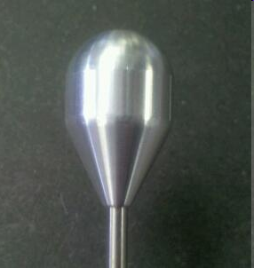
Mobile HF Antennas
Mobile antennas for HF are often some form of a ground plane (vertical whip)
Electrical loading is a technique for electrically lengthening a short mobile vertical to present a reasonable SWR - a capacitance hat is most efficient (end loading)
A shortened antenna will have very limited (narrower) operating bandwidth without retuning, a disadvantage
Screwdriver antennas with an adjustable coil (base-loading inductance) are a good compromise between performance and convenience
The purpose of a "corona ball" on a HF mobile antenna is to reduce RF voltage discharge from the tip of the antenna.

Slide 16
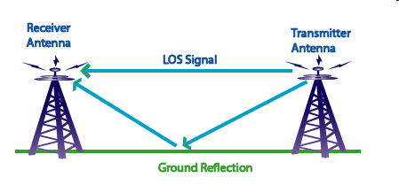
Effects of Polarization
Radio waves reflecting from the ground have lower losses when the polarization of the wave is parallel to the ground
Horizontally polarized antennas have lower ground reflection losses than vertically polarized antennas
Ground-mounted vertical antennas are able to generate stronger signals at lower angles of radiation than horizontal antennas at low heights - Vertical antennas are often preferred for DX contacts where it's impossible to erect tall towers and beams

Slide 17
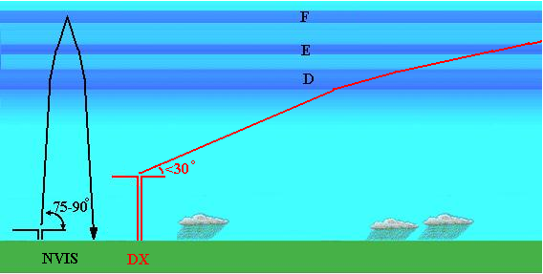
NVIS Antenna
NVIS (Near-Vertical Incidence Sky-wave) – antenna radiates mostly straight up to the ionosphere where it's reflected back down to Earth over a wide area
Pattern covers an area of only a few hundred kilometers across
Used for disaster communications
The best height is between ¹⁄10 and ¼ wavelength above ground
Typically a simple λ/2 dipole

Slide 18
Take Quiz 1

Slide 19
G4E01 - What is the purpose of a capacitance hat on a mobile antenna?
A. To increase the power handling capacity of a whip antenna
B. To reduce radiation resistance
C. To electrically lengthen a physically short antenna
D. To lower the radiation angle

Slide 20
G4E01 - What is the purpose of a capacitance hat on a mobile antenna?
A. To increase the power handling capacity of a whip antenna
B. To reduce radiation resistance
C. To electrically lengthen a physically short antenna
D. To lower the radiation angle

Slide 21
G4E02 - What is the purpose of a corona ball on an HF mobile antenna?
A. To narrow the operating bandwidth of the antenna
B. To increase the "Q" of the antenna
C. To reduce the chance of damage if the antenna should strike an object
D. To reduce RF voltage discharge from the tip of the antenna while transmitting

Slide 22
G4E02 - What is the purpose of a corona ball on an HF mobile antenna?
A. To narrow the operating bandwidth of the antenna
B. To increase the "Q" of the antenna
C. To reduce the chance of damage if the antenna should strike an object
D. To reduce RF voltage discharge from the tip of the antenna while transmitting

Slide 23
G4E06 - What is one disadvantage of using a shortened mobile antenna as opposed to a full-size antenna?
A. Short antennas are more likely to cause distortion of transmitted signals
B. Q of the antenna will be very low
C. Operating bandwidth may be very limited
D. Harmonic radiation may increase

Slide 24
G4E06 - What is one disadvantage of using a shortened mobile antenna as opposed to a full-size antenna?
A. Short antennas are more likely to cause distortion of transmitted signals
B. Q of the antenna will be very low
C. Operating bandwidth may be very limited
D. Harmonic radiation may increase

Slide 25
G9B02 - Which of the following is a common way to adjust the feed point impedance of an elevated quarter-wave ground-plane vertical antenna to be approximately 50 ohms?
A. Slope the radials upward
B. Slope the radials downward
C. Lengthen the radials beyond one wavelength
D. Coil the radials

Slide 26
G9B02 - Which of the following is a common way to adjust the feed point impedance of an elevated quarter-wave ground-plane vertical antenna to be approximately 50 ohms?
A. Slope the radials upward
B. Slope the radials downward
C. Lengthen the radials beyond one wavelength
D. Coil the radials

Slide 27
G9B03 - Which of the following best describes the radiation pattern of a quarter-wave ground-plane vertical antenna?
A. Bi-directional in azimuth
B. Isotropic
C. Hemispherical
D. Omnidirectional in azimuth

Slide 28
G9B03 - Which of the following best describes the radiation pattern of a quarter-wave ground-plane vertical antenna?
A. Bi-directional in azimuth
B. Isotropic
C. Hemispherical
D. Omnidirectional in azimuth

Slide 29
G9B04 - What is the radiation pattern of a dipole antenna in free space in a plane containing the conductor?
A. It is a figure-eight at right angles to the antenna
B. It is a figure-eight off both ends of the antenna
C. It is a circle (equal radiation in all directions)
D. It has a pair of lobes on one side of the antenna and a single lobe on the other side

Slide 30
G9B04 - What is the radiation pattern of a dipole antenna in free space in a plane containing the conductor?
A. It is a figure-eight at right angles to the antenna
B. It is a figure-eight off both ends of the antenna
C. It is a circle (equal radiation in all directions)
D. It has a pair of lobes on one side of the antenna and a single lobe on the other side

Slide 31
G9B05 - How does antenna height affect the azimuthal radiation pattern of a horizontal dipole HF antenna at elevation angles higher than about 45 degrees?
A. If the antenna is too high, the pattern becomes unpredictable
B. Antenna height has no effect on the pattern
C. If the antenna is less than 1/2 wavelength high, the azimuthal pattern is almost omnidirectional
D. If the antenna is less than 1/2 wavelength high, radiation off the ends of the wire is eliminated

Slide 32
G9B05 - How does antenna height affect the azimuthal radiation pattern of a horizontal dipole HF antenna at elevation angles higher than about 45 degrees?
A. If the antenna is too high, the pattern becomes unpredictable
B. Antenna height has no effect on the pattern
C. If the antenna is less than 1/2 wavelength high, the azimuthal pattern is almost omnidirectional
D. If the antenna is less than 1/2 wavelength high, radiation off the ends of the wire is eliminated

Slide 33
G9B06 - Where should the radial wires of a ground-mounted vertical antenna system be placed?
A. As high as possible above the ground
B. Parallel to the antenna element
C. On the surface or buried a few inches below the ground
D. At the center of the antenna

Slide 34
G9B06 - Where should the radial wires of a ground-mounted vertical antenna system be placed?
A. As high as possible above the ground
B. Parallel to the antenna element
C. On the surface or buried a few inches below the ground
D. At the center of the antenna

Slide 35
G9B07 - How does the feed point impedance of a horizontal 1/2 wave dipole antenna change as the antenna height is reduced to 1/10 wavelength above ground?
A. It steadily increases
B. It steadily decreases
C. It peaks at about 1/8 wavelength above ground
D. It is unaffected by the height above ground

Slide 36
G9B07 - How does the feed point impedance of a horizontal 1/2 wave dipole antenna change as the antenna height is reduced to 1/10 wavelength above ground?
A. It steadily increases
B. It steadily decreases
C. It peaks at about 1/8 wavelength above ground
D. It is unaffected by the height above ground

Slide 37
G9B08 - How does the feed point impedance of a 1/2 wave dipole change as the feed point is moved from the center toward the ends?
A. It steadily increases
B. It steadily decreases
C. It peaks at about 1/8 wavelength from the end
D. It is unaffected by the location of the feed point

Slide 38
G9B08 - How does the feed point impedance of a 1/2 wave dipole change as the feed point is moved from the center toward the ends?
A. It steadily increases
B. It steadily decreases
C. It peaks at about 1/8 wavelength from the end
D. It is unaffected by the location of the feed point

Slide 39
G9B09 - Which of the following is an advantage of using a horizontally polarized as compared to a vertically polarized HF antenna?
A. Lower ground losses
B. Lower feed point impedance
C. Shorter radials
D. Lower radiation resistance

Slide 40
G9B09 - Which of the following is an advantage of using a horizontally polarized as compared to a vertically polarized HF antenna?
A. Lower ground losses
B. Lower feed point impedance
C. Shorter radials
D. Lower radiation resistance

Slide 41
G9B10 - What is the approximate length for a 1/2 wave dipole antenna cut for 14.250 MHz?
A. 8 feet
B. 16 feet
C. 24 feet
D. 33 feet

Slide 42
G9B10 - What is the approximate length for a 1/2 wave dipole antenna cut for 14.250 MHz?
A. 8 feet
B. 16 feet
C. 24 feet
D. 33 feet

Slide 43
G9B11 - What is the approximate length for a 1/2 wave dipole antenna cut for 3.550 MHz?
A. 42 feet
B. 84 feet
C. 132 feet
D. 263 feet

Slide 44
G9B11 - What is the approximate length for a 1/2 wave dipole antenna cut for 3.550 MHz?
A. 42 feet
B. 84 feet
C. 132 feet
D. 263 feet

Slide 45
G9B12 - What is the approximate length for a 1/4 wave monopole antenna cut for 28.5 MHz?
A. 8 feet
B. 11 feet
C. 16 feet
D. 21 feet

Slide 46
G9B12 - What is the approximate length for a 1/4 wave monopole antenna cut for 28.5 MHz?
A. 8 feet
B. 11 feet
C. 16 feet
D. 21 feet

Slide 47
G9C04 - How does antenna gain in dBi compare to gain stated in dBd for the same antenna?
A. Gain in dBi is 2.15 dB lower
B. Gain in dBi is 2.15 dB higher
C. Gain in dBd is 1.25 dBd lower
D. Gain in dBd is 1.25 dBd higher

Slide 48
G9C04 - How does antenna gain in dBi compare to gain stated in dBd for the same antenna?
A. Gain in dBi is 2.15 dB lower
B. Gain in dBi is 2.15 dB higher
C. Gain in dBd is 1.25 dBd lower
D. Gain in dBd is 1.25 dBd higher

Slide 49
G9D01 - Which of the following antenna types will be most effective as a near vertical incidence skywave (NVIS) antenna for short-skip communications on 40 meters during the day?
A. A horizontal dipole placed between 1/10 and 1/4 wavelength above the ground
B. A vertical antenna placed between 1/4 and 1/2 wavelength above the ground
C. A horizontal dipole placed at approximately 1/2 wavelength above the ground
D. A vertical dipole placed at approximately 1/2 wavelength above the ground

Slide 50
G9D01 - Which of the following antenna types will be most effective as a near vertical incidence skywave (NVIS) antenna for short-skip communications on 40 meters during the day?
A. A horizontal dipole placed between 1/10 and 1/4 wavelength above the ground
B. A vertical antenna placed between 1/4 and 1/2 wavelength above the ground
C. A horizontal dipole placed at approximately 1/2 wavelength above the ground
D. A vertical dipole placed at approximately 1/2 wavelength above the ground

Slide 51
G9D02 - What is the feed point impedance of an end-fed half-wave antenna?
A. Very low
B. Approximately 50 ohms
C. Approximately 300 ohms
D. Very high

Slide 52
G9D02 - What is the feed point impedance of an end-fed half-wave antenna?
A. Very low
B. Approximately 50 ohms
C. Approximately 300 ohms
D. Very high

Slide 53
G9D08 - How does a "screwdriver" mobile antenna adjust its feed point impedance?
A. By varying its body capacitance
B. By varying the base loading inductance
C. By extending and retracting the whip
D. By deploying a capacitance hat

Slide 54
G9D08 - How does a "screwdriver" mobile antenna adjust its feed point impedance?
A. By varying its body capacitance
B. By varying the base loading inductance
C. By extending and retracting the whip
D. By deploying a capacitance hat

Slide 55
G9D12 - What is the common name of a dipole with a single central support?
A. Inverted V
B. Inverted L
C. Sloper
D. Lazy H

Slide 56
G9D12 - What is the common name of a dipole with a single central support?
A. Inverted V
B. Inverted L
C. Sloper
D. Lazy H

Slide 57
General License Course
Chapter 7.2 and 7.3
Yagi Antennas and
Loop Antennas

Slide 58
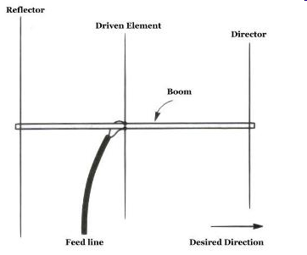
How Yagis Work
Yagi elements:
Driven element - connected to the feed line
Parasitic element(s) – one or more elements not connected to the feed line that influence the antenna’s radiation and receiving pattern
Parasitic arrays – energy from the driven element induces a current to flow in the parasitic elements which is re-radiated as part of the antenna’s total signal
Remember mutual inductance?

Slide 59
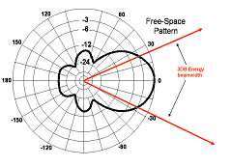
How Yagis Work
Yagi – the most popular directional antenna
Yagi antennas can be used to reduce interference, signals, and noise from unwanted directions
Directional antennas create a maximum field strength in a specific direction (main lobe)
(that's where gain comes from)

Slide 60
Yagi Structure & Function
A Yagi antenna has a driven element and at least one parasitic element
Driven element – about 1/2 λ (a dipole)
Director element(s) – reinforce signals in a single main lobe (~5% shorter than the driven element)
Reflector – cancel signals to the rear (~5% longer than the driven element)
Front-to-back ratio is the ratio of signal strength at the peak of the radiation pattern's major lobe to that in exactly the opposite direction

Slide 61
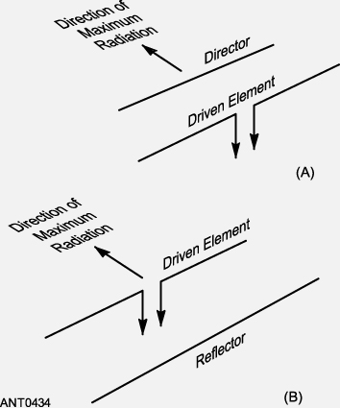
Yagi Structure
The simplest Yagi is a two-element antenna with a driven element (DE) and either a reflector (usually) or a director.
DE is a λ/2 dipole
Reflector element is about 5% longer than the driven element and placed behind the DE by 0.1-0.2 λ
Director element is about 5% shorter than the driven element and placed ahead of the DE by 0.15-0.2 λ

Slide 62
Design Tradeoffs
Yagi design variables (gain, F-B ratio, SWR bandwidth) are boom length, number of elements, and element spacing (all three)
Placement and length of the elements affects gain, resonance, bandwidth, SWR, and pattern
Increasing boom length and adding directors increases gain
Larger diameter elements increase SWR bandwidth
Antenna modeling software can be used to optimize the antenna design

Slide 63
Preview of Feed Lines…
Forward power – power traveling toward an antenna (load)
Reflected power – power reflected from an impedance mismatch at the antenna
Standing waves – interference wave pattern in a feed line from forward and reverse power
Standing wave ratio (SWR) equals the ratio of the antenna's impedance to the impedance of the feed line (with the lower Z = 1: always X:1)
Short or open circuit at the feedpoint: SWR = infinite and all power reflected

Slide 64
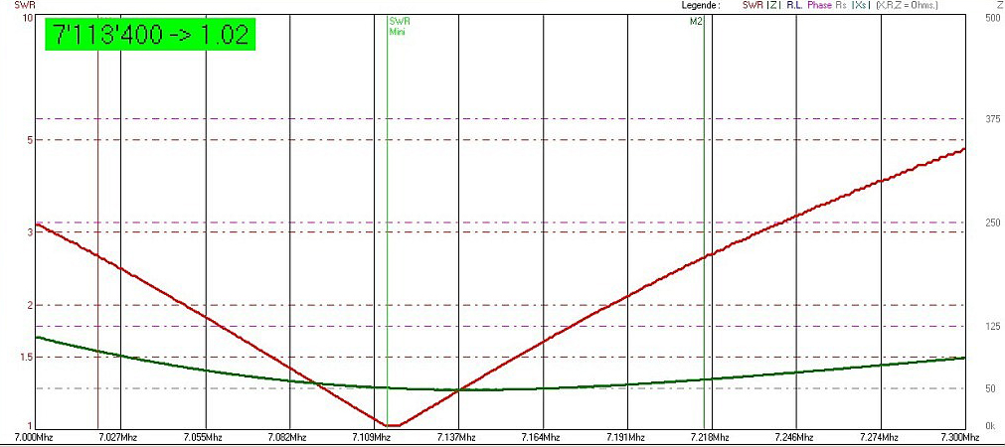
Bandwidth

Slide 65
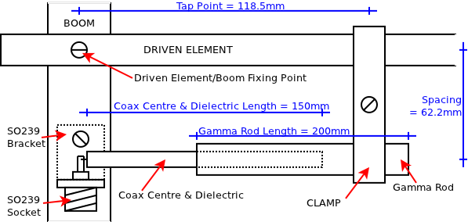
Impedance Matching – Gamma Match
Most Yagi designs have a relatively low feed point impedance requiring a matching network to match 50 ohm feed lines.
Gamma matching: the coax shield is connected to the center of the driven element, the center conductor is connected through a tubular capacitor to a tap point on the driven element
Mechanical advantage - the driven element doesn't have to be insulated from the boom
Tune by adjusting the DE tap point and/or the capacitance

Slide 66
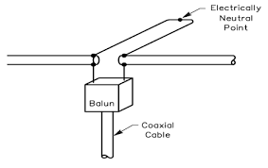
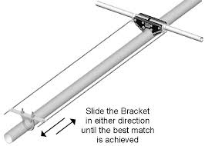
Impedance Matching – Beta Match
The Beta (or “hairpin”) match is a short length of parallel conductor transmission line (shorted transmission line stub), shorted at one end, with the other end connected in parallel with the driven element feed point.
Its inductance compensates for the capacitive reactance at the feed point, bringing the impedance of the yagi up to 50 ohms.
D.E. insulated from the boom

Slide 67
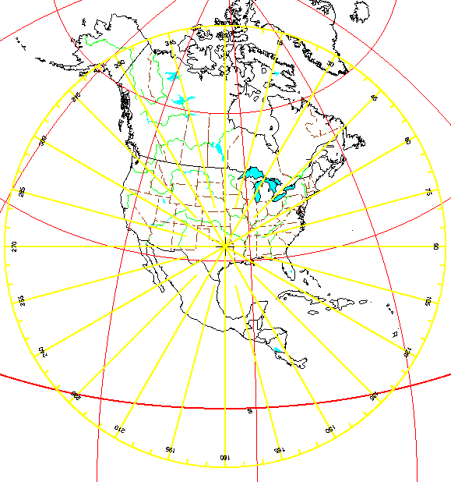
Operating Procedures
To determine where to point a directional antenna use an azimuthal projection map
An azimuthal projection map is a world map projection centered on a particular location, showing true bearings and distances from that location

Slide 68
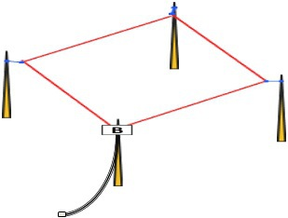
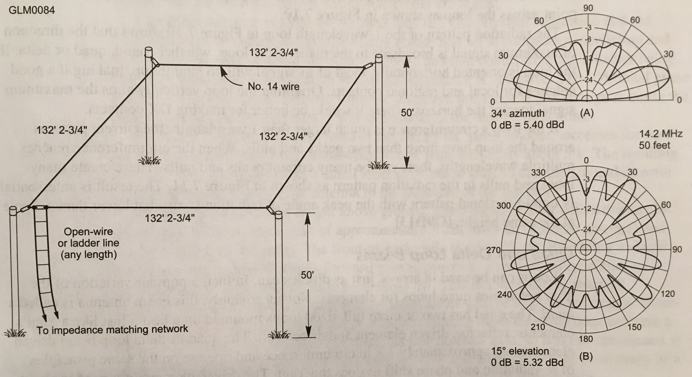
Large Horizontal Loops
If a loop’s circumference is multiple wavelengths long many peaks and nulls appear in the radiation pattern, making the loop essentially omnidirectional with a lower peak vertical (elevation) angle than a dipole mounted at the same height.
160 meter loop – 20 meter pattern

Slide 69
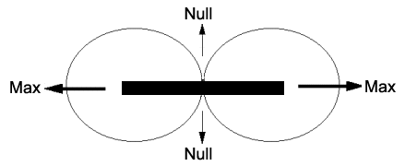
Small Loops
In loops with circumferences of less than 1/3 λ, current in the loop becomes relatively uniform throughout the loop. The resulting radiation pattern features sharp nulls broadside to the plane of the loop (the opposite of 1 λ loops)
Loop viewed from above

Slide 70
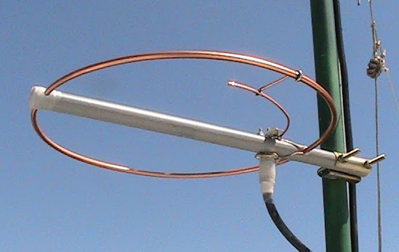
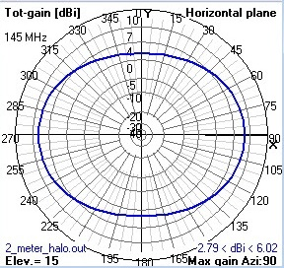
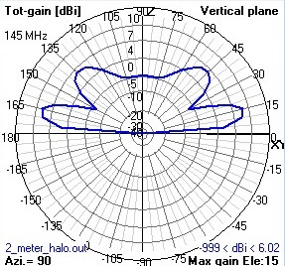
Halo Antenna
A Halo isn’t really a loop. It’s a ½ λ dipole bent into a circle or square (“squalo’”) with the ends separated by a small gap. Maximum radiation is in the plane of the antenna and its pattern is largely omnidirectional.

Slide 71
Take Quiz 2

Slide 72
G2D04 - Which of the following describes an azimuthal projection map?
A. A map that shows accurate land masses
B. A map that shows true bearings and distances from a specific location
C. A map that shows the angle at which an amateur satellite crosses the equator
D. A map that shows the number of degrees longitude that an amateur satellite appears to move westward at the equator with each orbit

Slide 73
G2D04 - Which of the following describes an azimuthal projection map?
A. A map that shows accurate land masses
B. A map that shows true bearings and distances from a specific location
C. A map that shows the angle at which an amateur satellite crosses the equator
D. A map that shows the number of degrees longitude that an amateur satellite appears to move westward at the equator with each orbit

Slide 74
G9C01 - Which of the following would increase the bandwidth of a Yagi antenna?
A. Larger-diameter elements
B. Closer element spacing
C. Loading coils in series with the element
D. Tapered-diameter elements

Slide 75
G9C01 - Which of the following would increase the bandwidth of a Yagi antenna?
A. Larger-diameter elements
B. Closer element spacing
C. Loading coils in series with the element
D. Tapered-diameter elements

Slide 76
G9C02 - What is the approximate length of the driven element of a Yagi antenna?
A. 1/4 wavelength
B. 1/2 wavelength
C. 3/4 wavelength
D. 1 wavelength

Slide 77
G9C02 - What is the approximate length of the driven element of a Yagi antenna?
A. 1/4 wavelength
B. 1/2 wavelength
C. 3/4 wavelength
D. 1 wavelength

Slide 78
G9C03 - How do the lengths of a three-element Yagi reflector and director compare to that of the driven element?
A. The reflector is longer, and the director is shorter
B. The reflector is shorter, and the director is longer
C. They are all the same length
D. Relative length depends on the frequency of operation

Slide 79
G9C03 - How do the lengths of a three-element Yagi reflector and director compare to that of the driven element?
A. The reflector is longer, and the director is shorter
B. The reflector is shorter, and the director is longer
C. They are all the same length
D. Relative length depends on the frequency of operation

Slide 80
G9C05 - What is the primary effect of increasing boom length and adding directors to a Yagi antenna?
A. Gain increases
B. Beamwidth increases
C. Front-to-back ratio decreases
D. Resonant frequency is lower

Slide 81
G9C05 - What is the primary effect of increasing boom length and adding directors to a Yagi antenna?
A. Gain increases
B. Beamwidth increases
C. Front-to-back ratio decreases
D. Resonant frequency is lower

Slide 82
G9C07 - What does "front-to-back ratio" mean in reference to a Yagi antenna?
A. The number of directors versus the number of reflectors
B. The relative position of the driven element with respect to the reflectors and directors
C. The power radiated in the major lobe compared to that in the opposite direction
D. The ratio of forward gain to dipole gain

Slide 83
G9C07 - What does "front-to-back ratio" mean in reference to a Yagi antenna?
A. The number of directors versus the number of reflectors
B. The relative position of the driven element with respect to the reflectors and directors
C. The power radiated in the major lobe compared to that in the opposite direction
D. The ratio of forward gain to dipole gain

Slide 84
G9C08 - What is meant by the "main lobe" of a directive antenna?
A. The magnitude of the maximum vertical angle of radiation
B. The point of maximum current in a radiating antenna element
C. The maximum voltage standing wave point on a radiating element
D. The direction of maximum radiated field strength from the antenna

Slide 85
G9C08 - What is meant by the "main lobe" of a directive antenna?
A. The magnitude of the maximum vertical angle of radiation
B. The point of maximum current in a radiating antenna element
C. The maximum voltage standing wave point on a radiating element
D. The direction of maximum radiated field strength from the antenna

Slide 86
G9C10 - Which of the following can be adjusted to optimize forward gain, front-to-back ratio, or SWR bandwidth of a Yagi antenna?
A. The physical length of the boom
B. The number of elements on the boom
C. The spacing of each element along the boom
D. All these choices are correct

Slide 87
G9C10 - Which of the following can be adjusted to optimize forward gain, front-to-back ratio, or SWR bandwidth of a Yagi antenna?
A. The physical length of the boom
B. The number of elements on the boom
C. The spacing of each element along the boom
D. All these choices are correct

Slide 88
G9C11 - What is a beta or hairpin match?
A. A shorted transmission line stub placed at the feed point of a Yagi antenna to provide impedance matching
B. A 1/4 wavelength section of 75-ohm coax in series with the feed point of a Yagi to provide impedance matching
C. A series capacitor selected to cancel the inductive reactance of a folded dipole antenna
D. A section of 300-ohm twin-lead transmission line used to match a folded dipole antenna

Slide 89
G9C11 - What is a beta or hairpin match?
A. A shorted transmission line stub placed at the feed point of a Yagi antenna to provide impedance matching
B. A 1/4 wavelength section of 75-ohm coax in series with the feed point of a Yagi to provide impedance matching
C. A series capacitor selected to cancel the inductive reactance of a folded dipole antenna
D. A section of 300-ohm twin-lead transmission line used to match a folded dipole antenna

Slide 90
G9C12 - Which of the following is a characteristic of using a gamma match with a Yagi antenna?
A. It does not require the driven element to be insulated from the boom
B. It does not require any inductors or capacitors
C. It is useful for matching multiband antennas
D. All these choices are correct

Slide 91
G9C12 - Which of the following is a characteristic of using a gamma match with a Yagi antenna?
A. It does not require the driven element to be insulated from the boom
B. It does not require any inductors or capacitors
C. It is useful for matching multiband antennas
D. All these choices are correct

Slide 92
G9D03 - In which direction is the maximum radiation from a VHF/UHF "halo" antenna?
A. Broadside to the plane of the halo
B. Opposite the feed point
C. Omnidirectional in the plane of the halo
D. On the same side as the feed point

Slide 93
G9D03 - In which direction is the maximum radiation from a VHF/UHF "halo" antenna?
A. Broadside to the plane of the halo
B. Opposite the feed point
C. Omnidirectional in the plane of the halo
D. On the same side as the feed point

Slide 94
G9D10 - In which direction or directions does an electrically small loop (less than 1/10 wavelength in circumference) have nulls in its radiation pattern?
A. In the plane of the loop
B. Broadside to the loop
C. Broadside and in the plane of the loop
D. Electrically small loops are omnidirectional

Slide 95
G9D10 - In which direction or directions does an electrically small loop (less than 1/10 wavelength in circumference) have nulls in its radiation pattern?
A. In the plane of the loop
B. Broadside to the loop
C. Broadside and in the plane of the loop
D. Electrically small loops are omnidirectional

Slide 96
General License Course
Chapter 7.4
Specialized Antennas

Slide 97
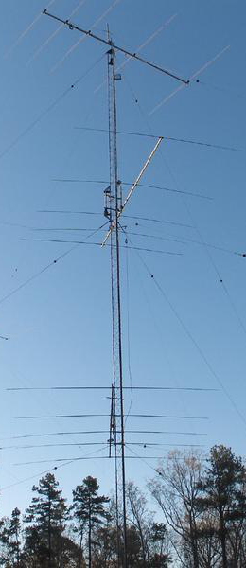
Specialized Antennas
Stacked Antennas – identical antennas stacked above or beside each other to increase gain
Vertical stacking of horizontally polarized yagis increases gain and narrows the main lobe in elevation
Antennas in a vertical stack are usually about ½ wavelength to 1 wavelength apart

Slide 98
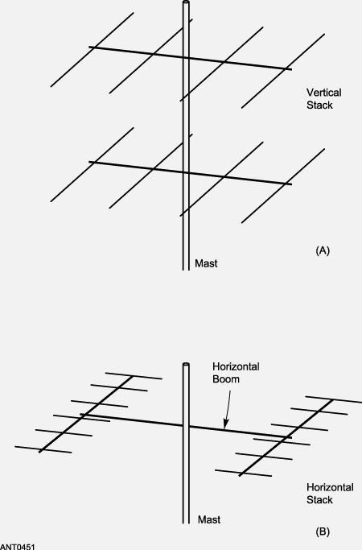
Specialized Antennas
Stacking 2 identical beams ½ wavelength apart increases gain by 3 dB
Gain another 3 dB by stacking 4 beam antennas
Stacking horizontally narrows the azmuthal pattern beamwidth

Slide 99
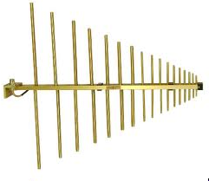
Specialized Antennas
Log Periodics – are designed to have a consistent radiation pattern and SWR across a wide (up to 10:1) frequency range (wide bandwidth)
Short elements are active at higher frequencies, longer elements are active at lower frequencies
Log periodic antennas have less gain and lower front-to-back ratio than Yagi antennas
The length and spacing of the elements increases logarithmically from one end of the boom to the other
See next page...

Slide 100
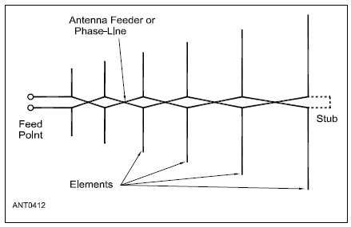
Log Periodic Antenna

Slide 101
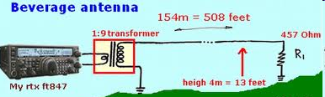
Specialized Antennas
Beverage antenna – directional low-band receive-only antenna
Beverage antennas are very inefficient (high loss) but do a good job of rejecting noise coming from non-preferred directions. They are not suitable for transmitting
A Beverage antenna is a long, low wire (less than 20 ft high) pointed in a preferred signal direction
Receive direction

Slide 102
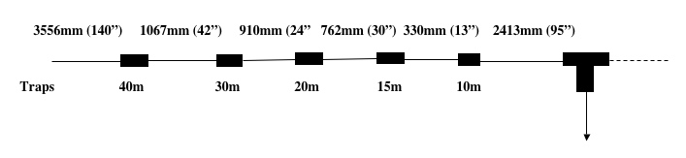
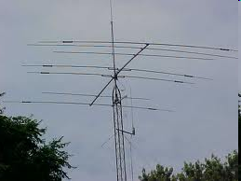
Multiband Antennas
A Trapped dipole is a common multiband antenna
The traps act as electrical switches to isolate parts of the antenna to permit multiband operation
Triband Yagi (10-15-20 meters) can be trapped or have separate elements for each frequency
Disadvantage: multiband antennas have poor harmonic rejection

Slide 103
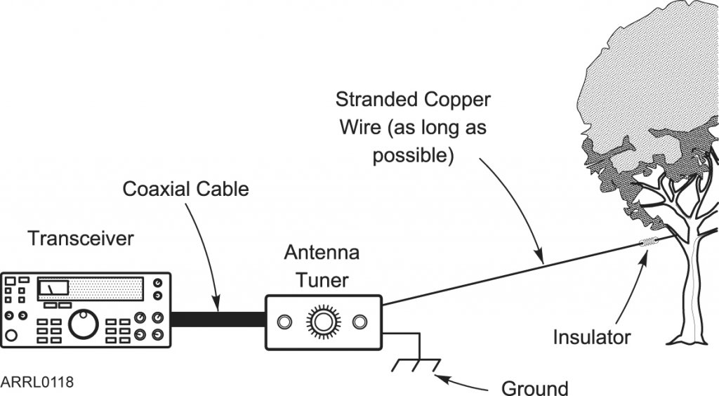
Random Wire Antenna
End fed directly at the transmitter or antenna matching device – they can work very well
Ground connections are part of the antenna
You may experience RF burns when touching metal station components when transmitting!

Slide 104
Take Quiz 3

Slide 105
G9B01 - What is a characteristic of a random-wire HF antenna connected directly to the transmitter?
A. It must be longer than 1 wavelength
B. Station equipment may carry significant RF current
C. It produces only vertically polarized radiation
D. It is more effective on the lower HF bands than on the higher bands

Slide 106
G9B01 - What is a characteristic of a random-wire HF antenna connected directly to the transmitter?
A. It must be longer than 1 wavelength
B. Station equipment may carry significant RF current
C. It produces only vertically polarized radiation
D. It is more effective on the lower HF bands than on the higher bands

Slide 107
G9C09 - In free space, how does the gain of two three-element, horizontally polarized Yagi antennas spaced vertically 1/2 wavelength apart typically compare to the gain of a single three-element Yagi?
A. Approximately 1.5 dB higher
B. Approximately 3 dB higher
C. Approximately 6 dB higher
D. Approximately 9 dB higher

Slide 108
G9C09 - In free space, how does the gain of two three-element, horizontally polarized Yagi antennas spaced vertically 1/2 wavelength apart typically compare to the gain of a single three-element Yagi?
A. Approximately 1.5 dB higher
B. Approximately 3 dB higher
C. Approximately 6 dB higher
D. Approximately 9 dB higher

Slide 109
G9D04 - What is the primary function of antenna traps?
A. To enable multiband operation
B. To notch spurious frequencies
C. To provide balanced feed point impedance
D. To prevent out-of-band operation

Slide 110
G9D04 - What is the primary function of antenna traps?
A. To enable multiband operation
B. To notch spurious frequencies
C. To provide balanced feed point impedance
D. To prevent out-of-band operation

Slide 111
G9D05 - What is an advantage of vertically stacking horizontally polarized Yagi antennas?
A. It allows quick selection of vertical or horizontal polarization
B. It allows simultaneous vertical and horizontal polarization
C. It narrows the main lobe in azimuth
D. It narrows the main lobe in elevation

Slide 112
G9D05 - What is an advantage of vertically stacking horizontally polarized Yagi antennas?
A. It allows quick selection of vertical or horizontal polarization
B. It allows simultaneous vertical and horizontal polarization
C. It narrows the main lobe in azimuth
D. It narrows the main lobe in elevation

Slide 113
G9D06 - Which of the following is an advantage of a log-periodic antenna?
A. Wide bandwidth
B. Higher gain per element than a Yagi antenna
C. Harmonic suppression
D. Polarization diversity

Slide 114
G9D06 - Which of the following is an advantage of a log-periodic antenna?
A. Wide bandwidth
B. Higher gain per element than a Yagi antenna
C. Harmonic suppression
D. Polarization diversity

Slide 115
G9D07 - Which of the following describes a log-periodic antenna?
A. Element length and spacing vary logarithmically along the boom
B. Impedance varies periodically as a function of frequency
C. Gain varies logarithmically as a function of frequency
D. SWR varies periodically as a function of boom length

Slide 116
G9D07 - Which of the following describes a log-periodic antenna?
A. Element length and spacing vary logarithmically along the boom
B. Impedance varies periodically as a function of frequency
C. Gain varies logarithmically as a function of frequency
D. SWR varies periodically as a function of boom length

Slide 117
G9D09 - What is the primary use of a Beverage antenna?
A. Directional receiving for MF and low HF bands
B. Directional transmitting for low HF bands
C. Portable direction finding at higher HF frequencies
D. Portable direction finding at lower HF frequencies

Slide 118
G9D09 - What is the primary use of a Beverage antenna?
A. Directional receiving for MF and low HF bands
B. Directional transmitting for low HF bands
C. Portable direction finding at higher HF frequencies
D. Portable direction finding at lower HF frequencies

Slide 119
G9D11 - Which of the following is a disadvantage of multiband antennas?
A. They present low impedance on all design frequencies
B. They must be used with an antenna tuner
C. They must be fed with open wire line
D. They have poor harmonic rejection

Slide 120
G9D11 - Which of the following is a disadvantage of multiband antennas?
A. They present low impedance on all design frequencies
B. They must be used with an antenna tuner
C. They must be fed with open wire line
D. They have poor harmonic rejection

Slide 121
Next Week
Chapters 7.5 and 9

